Slide 1

FILM MAKING COMPANY
Plan for success of the film making company

Slide 2
MOVIE ANALYSIS

Slide 3
Outline
1.Summary
2.Business Problem
3.Goals
4.Data
5.Methods
6.Results
7.Conclusions
8.Next Steps

Slide 4
SuMMARY
This analysis is for a film making company that wants to emerge best at the box office. This analysis will help this company to know what features of the TMDB database to put in consideration in order to be more profitable. This analysis will focus on Genres, ReleaseDate, Revenue, Budget, ProductionCompanies, Runtime columns.
I

Slide 5
Business PROBLEM
1.A film making company has not been performing well at the box office. The company needs guidance on how to improve on their performance in order to emerge best at the box office.
2.Indentify factors of success of the industry

Slide 6
GoalS
Develop a strategic, to emerge best at the box office
Create an optimal business strategy to be successful

Slide 7
Data
I will use the following dataset:
TMDB_7000_Top_Rated_Movies dataset
TMDB_10000_Popular_Movies dataset
[Link here](https://www.kaggle.com/datasets/ritayandhara/tmdb-dataset)

Slide 8
Methods
Data Preparation
I familiarized myself with the datasets and got two know what columns I was working with in order to decide how to join the two datasets. I cleaned the datasets by :
Renaming column names
Checking for duplicates and removing them
Dropping the rows with null values
Changing the datatypes of columns into their correct datatypes
Visualization and Analysis
Bargraph, Scatterplots, Heatmap, Lineplot, countplot, PIeChart

Slide 9
Genres
The most profitable Genre
High budget
Low budget
The most rated Genre

Slide 10
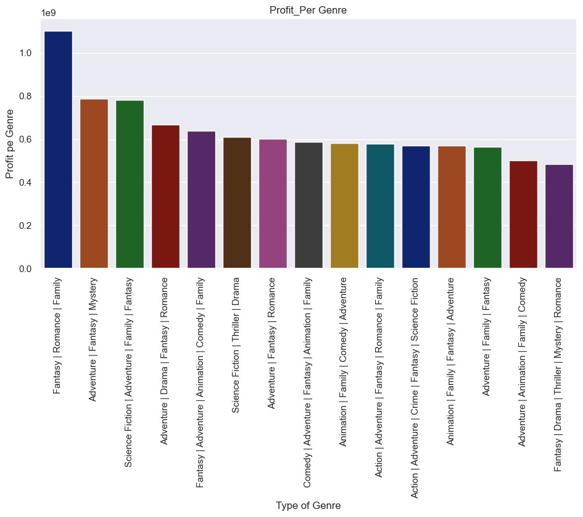
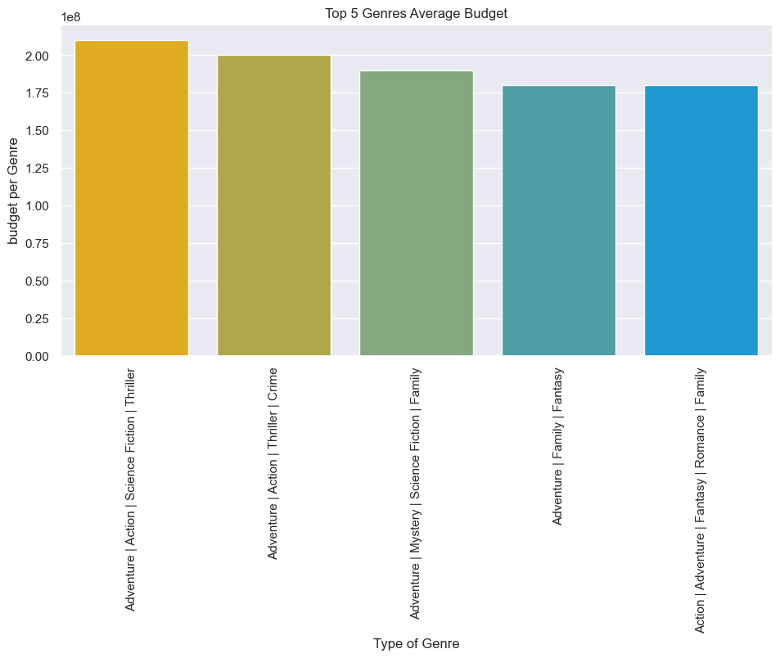
Most profitable movie genres
Low budget
High Budget

Slide 11
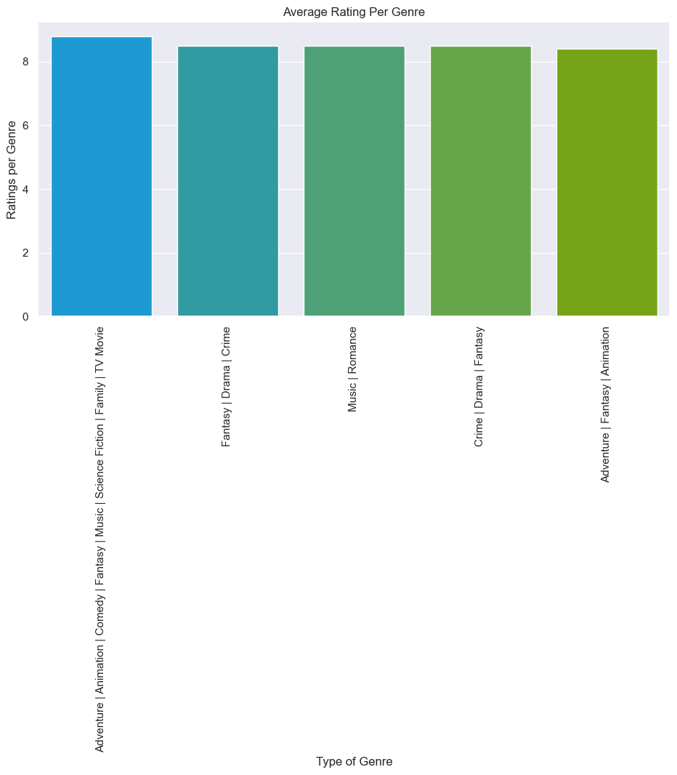
THE MOST RATED MOVIE GENRE

Slide 12
RELEASE_DATE(RELEASE_MONTH)
The month with the most films released
The most profitable month
The Release Month whose films are highly rated

Slide 13
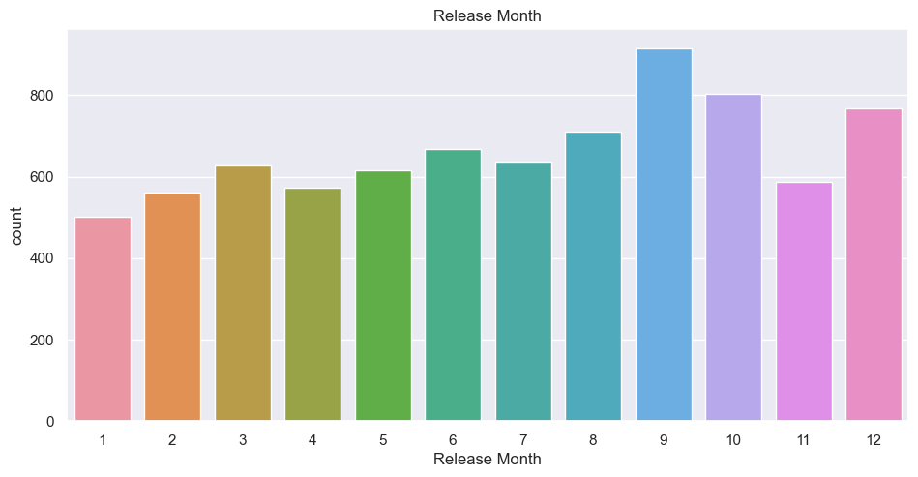
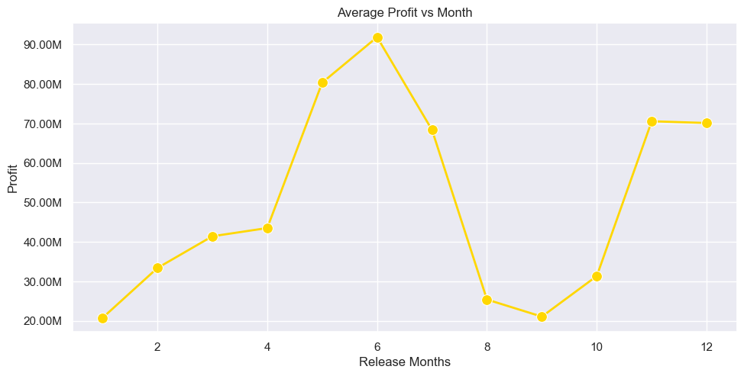
Most profitable release month
The release months
The most profitable release month

Slide 14
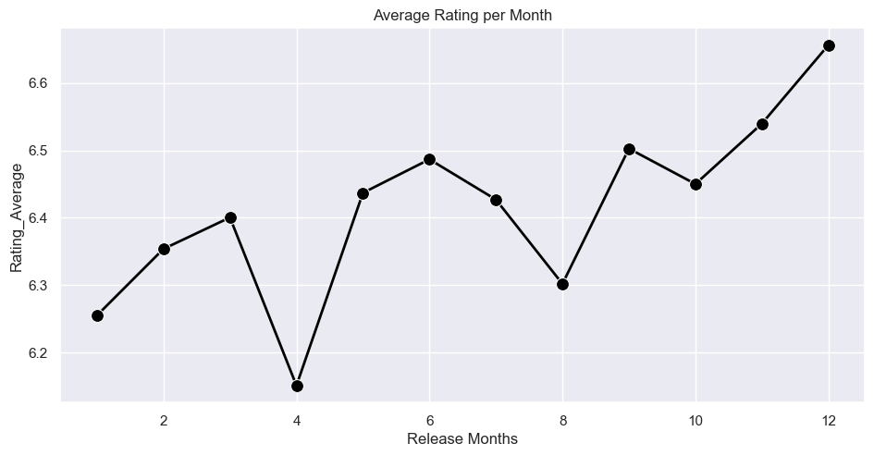
The release months whose films are highly rated

Slide 15
Rating average
What is the rating of most movies

Slide 16
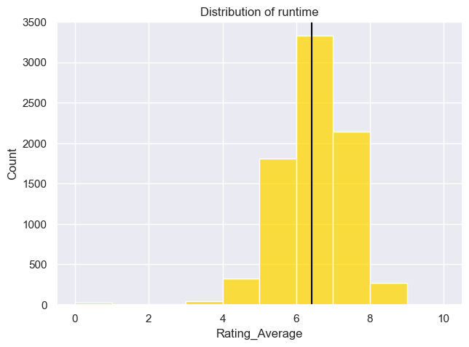
the rating of movies

Slide 17
RUNTIME
What is the most profitable runtime minutes of a movie

Slide 18
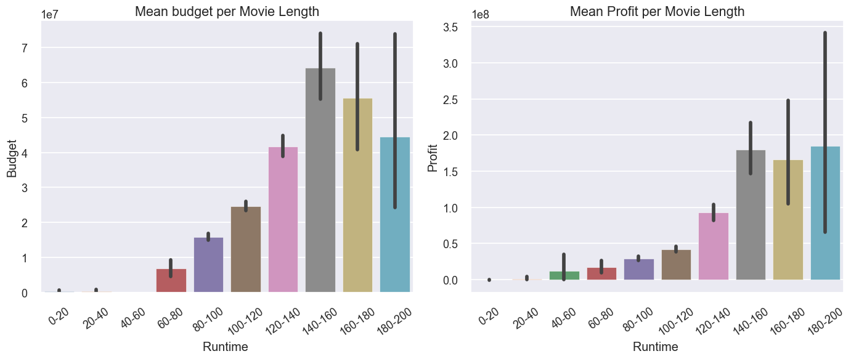
THE MOST PROFITABLE RUNTIME
The recommended runtime minutes is 140-160 minutes which is around 2hrs 30minutes

Slide 19
PRODUCTION COMPANIES
Which is the most profitable production company

Slide 20
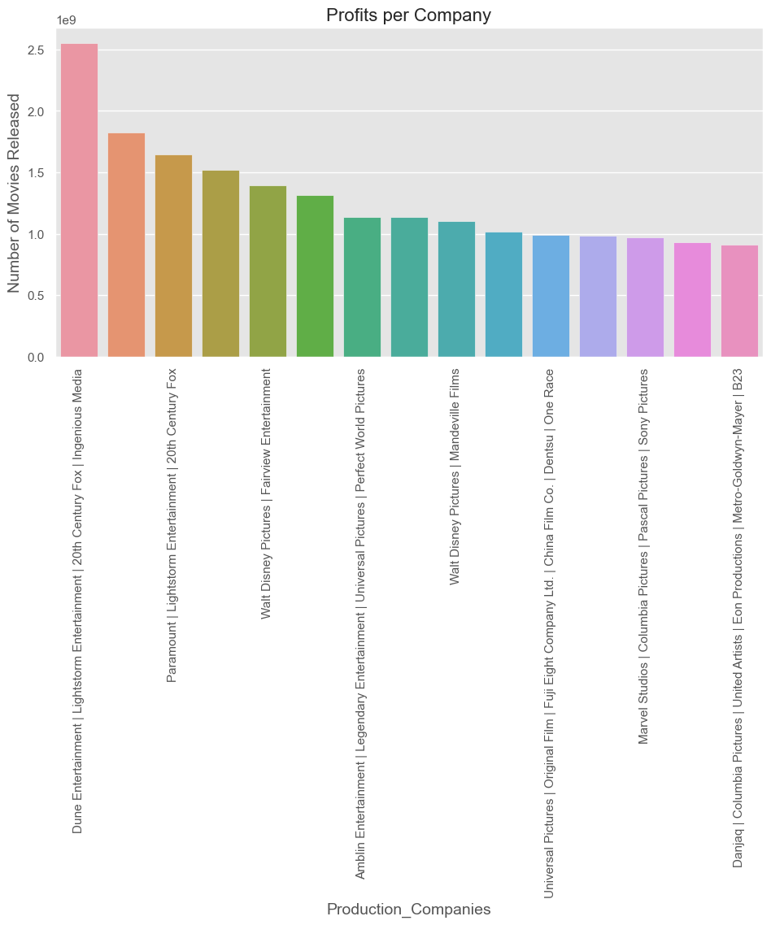
Profits per company
The most profitable company is Dune Entertainment | Lightstorm Entertainment | 20th Centuary Fox | Ingenious Media

Slide 21
Original language
The most spoken language in films produced
The most profitable language

Slide 22
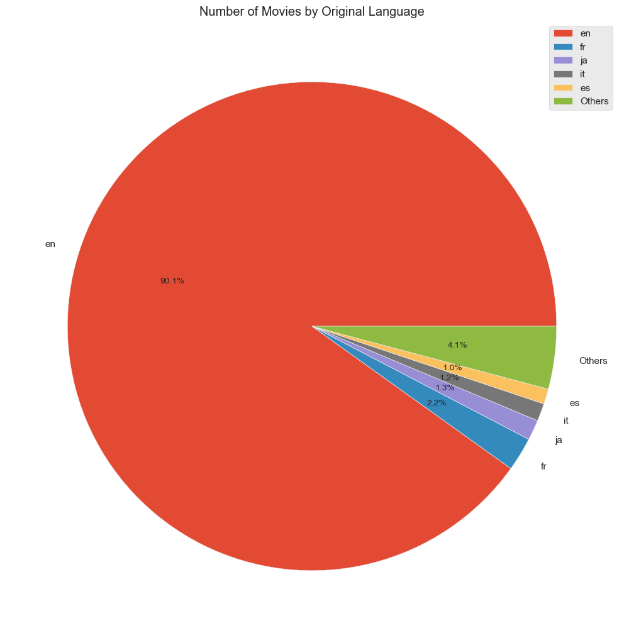
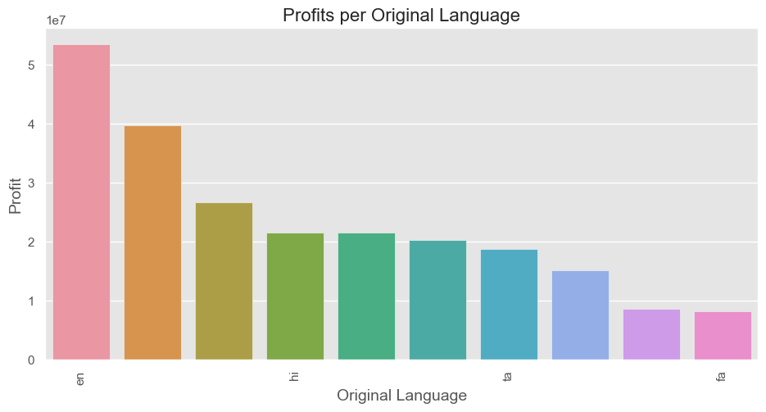
Languages used in movies
The most used languages in making films
The most profitable language used in films

Slide 23
conclusion
Final recommendation for the film making company:
1. Genres
Low budget
'Fantasy | Romance | Family', then followed by 'Adventure | Fantasy | Mystery'
High budget
Fantasy | Adventure | Animation | Comedy | Family‘ genre, Action | Adventure | Fantasy |Romance |Family'
Rating
Adventure | Animation |Comedy | Fantasy | Music | Science Fiction |Family | Tv Movie , Fantasy | Drama |Crime genres
2. Release_Date(Release_Month)
June then May because they are the most profitable months
3. Runtime
140-160 minutes. which is 2hrs 20minutes
4. Production Companies to partner with
Dune Entertainment | Lightstorm Entertainment | 20th Centuary Fox | Ingenious Media
5. Original Language
English

Slide 24
NEXT STEP
Further analyses could yield additional insights to further improve operations at the film making company:
Priority on this analysis is based on relationship among the Top_10 genres, Ratings, Best Month, Runtime and Production Companies.
Conduct analysis on a related dataset to find other recommendations for the film making to improve analysis of the company
Marketing plays a big part in movie success. Examining this data could give insights on how audiences respond to different marketing techniques when promoting a movie.

Slide 25
THANK YOU

